Slide 1
ALGORITHMS
SUBMITTED BY-ASHISH AGGARWAL
CSE 2ND YEAR
181210012

Slide 2
CONTENT-
1. Divide and conquer
2. Backtracking
3. Greedy method
4. Dynamic programming
5. Branch and bound
6.Bibliography

Slide 3
Divide and conquer
In divide and conquer approach, the problem in hand, is divided into smaller sub-problems and then each problem is solved independently. When we keep on dividing the sub problems into even smaller sub-problems, we may eventually reach a stage where no more division is possible. Those "atomic" smallest possible sub-problem (fractions) are solved. The solution of all sub-problems is finally merged in order to obtain the solution of an original problem.

Slide 4
Broadly, we can understand divide-and-conquer approach in a three-step process.
Divide/Break
This step involves breaking the problem into smaller sub-problems. Sub-problems should represent a part of the original problem. This step generally takes a recursive approach to divide the problem until no sub-problem is further divisible. At this stage, sub-problems become atomic in nature but still represent some part of the actual problem.
Conquer/Solve
This step receives a lot of smaller sub-problems to be solved. Generally, at this level, the problems are considered 'solved' on their own.
Merge/Combine
When the smaller sub-problems are solved, this stage recursively combines them until they formulate a solution of the original problem. This algorithmic approach works recursively and conquer & merge steps works so close that they appear as one.

Slide 5
ADANTAGES
Solving difficult problems-
Divide and conquer is a powerful tool for solving conceptually difficult problems: all it requires is a way of breaking the problem into sub-problems, of solving the trivial cases and of combining sub-problems to the original problem.
Algorithm efficiency
The divide-and-conquer paradigm often helps in the discovery of efficient algorithms.
Parallelism
Divide-and-conquer algorithms are naturally adapted for execution in multi-processor machines, especially shared-memory systems where the communication of data between processors does not need to be planned in advance, because distinct sub-problems can be executed on different processors.

Slide 6
ADVANTAGES
Memory access
Divide-and-conquer algorithms naturally tend to make efficient use of memory caches. The reason is that once a sub-problem is small enough, it and all its sub-problems can, in principle, be solved within the cache, without accessing the slower main memory.
Roundoff control
In computations with rounded arithmetic, e.g. with floating-point numbers, a divide-and-conquer algorithm may yield more accurate results than a superficially equivalent iterative method.

Slide 7
MASTER THEORUM
In the analysis of algorithms, the master theorem for divide-and-conquer recurrences provides an asymptotic analysis (using Big O notation) for recurrence relations of types that occur in the analysis of many divide and conquer algorithms
The runtime of an algorithm such as the 'p' above on an input of size 'n', usually denoted {\displaystyle T(n)}, can be expressed by the recurrence relation
T(n)=aT(n/b)+f(n)

Slide 8
EXAMPLES
The following computer algorithms are based on divide-and-conquer programming approach −
Merge Sort
Quick Sort
Binary Search
Strassen's Matrix Multiplication
Closest pair (points)
There are various ways available to solve any computer problem, but the mentioned are a good example of divide and conquer approach.

Slide 9
PROBLEM-
Given number of pages in n different books and m students. The books are arranged in ascending order of number of pages. Every student is assigned to read some consecutive books. The task is to assign books in such a way that the maximum number of pages assigned to a student is minimum

Slide 10
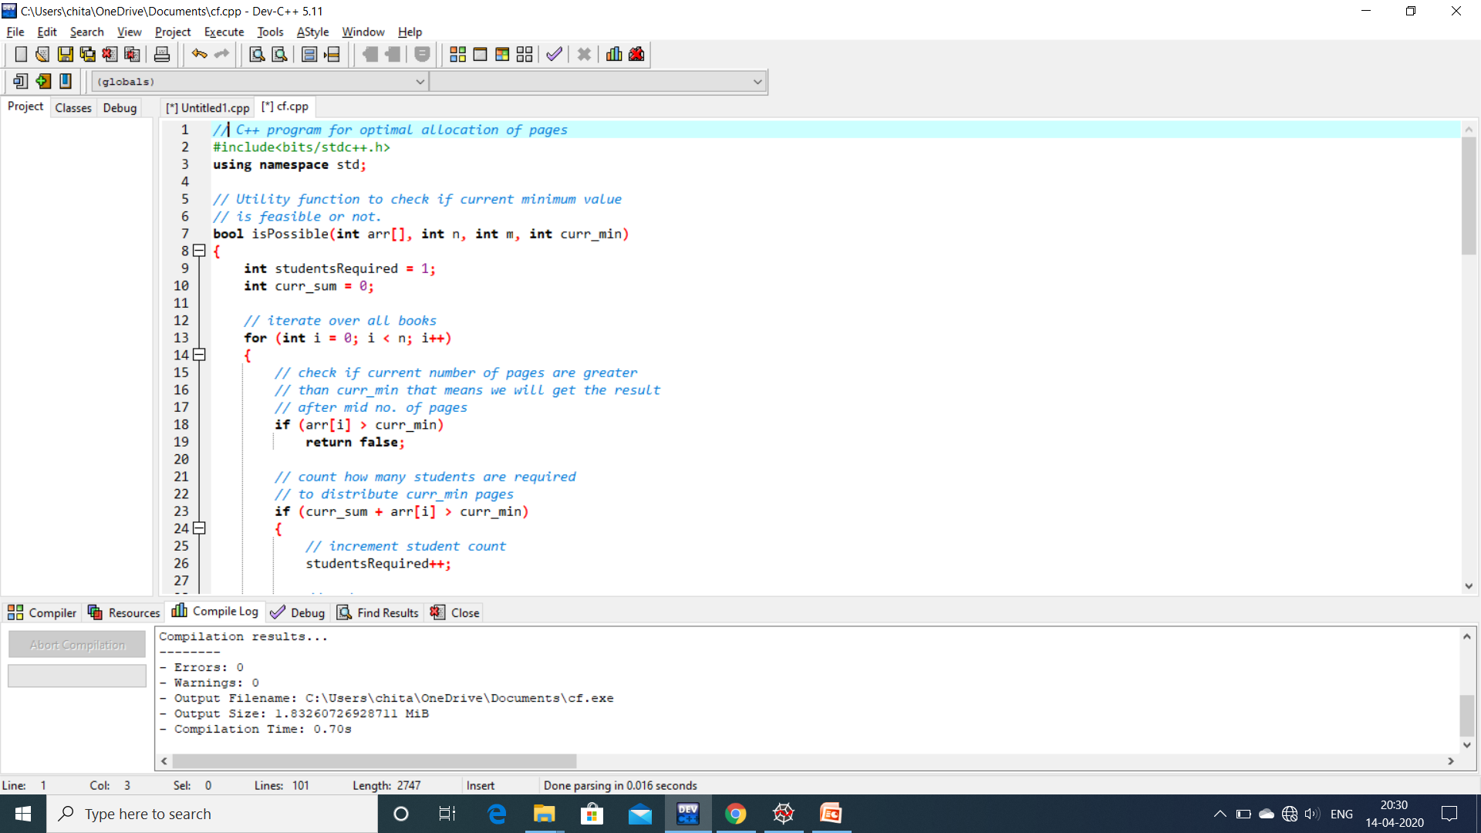

Slide 11
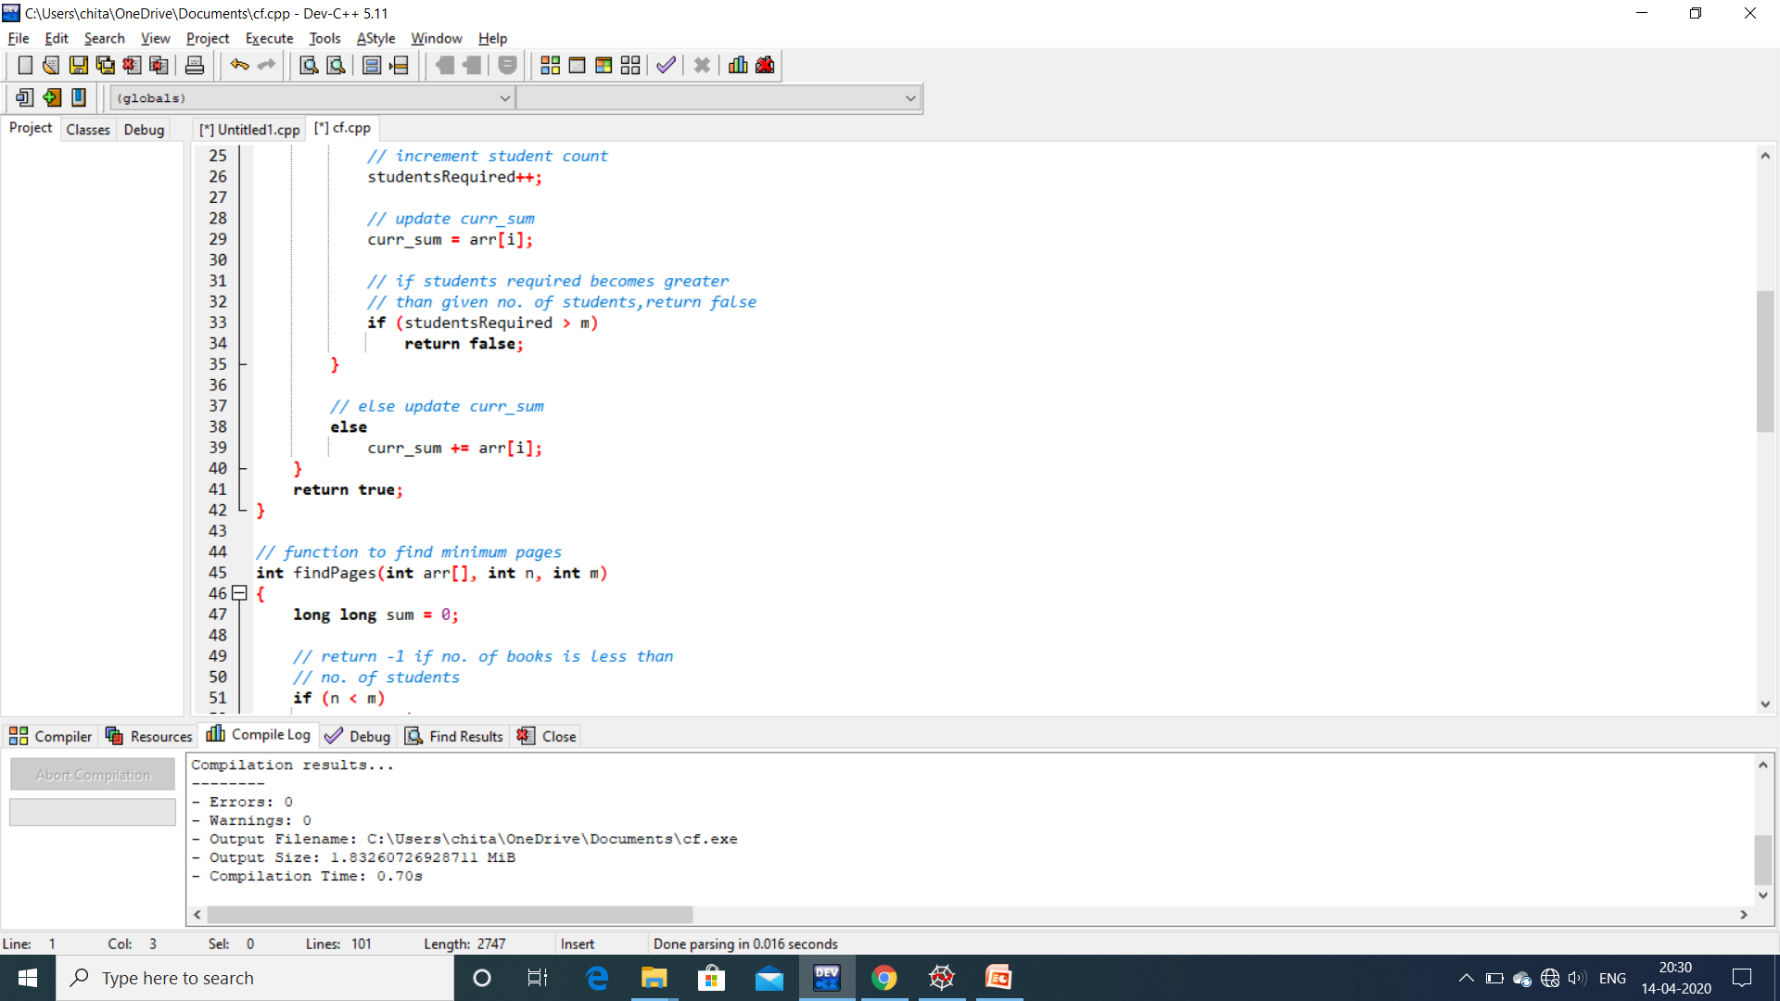

Slide 12
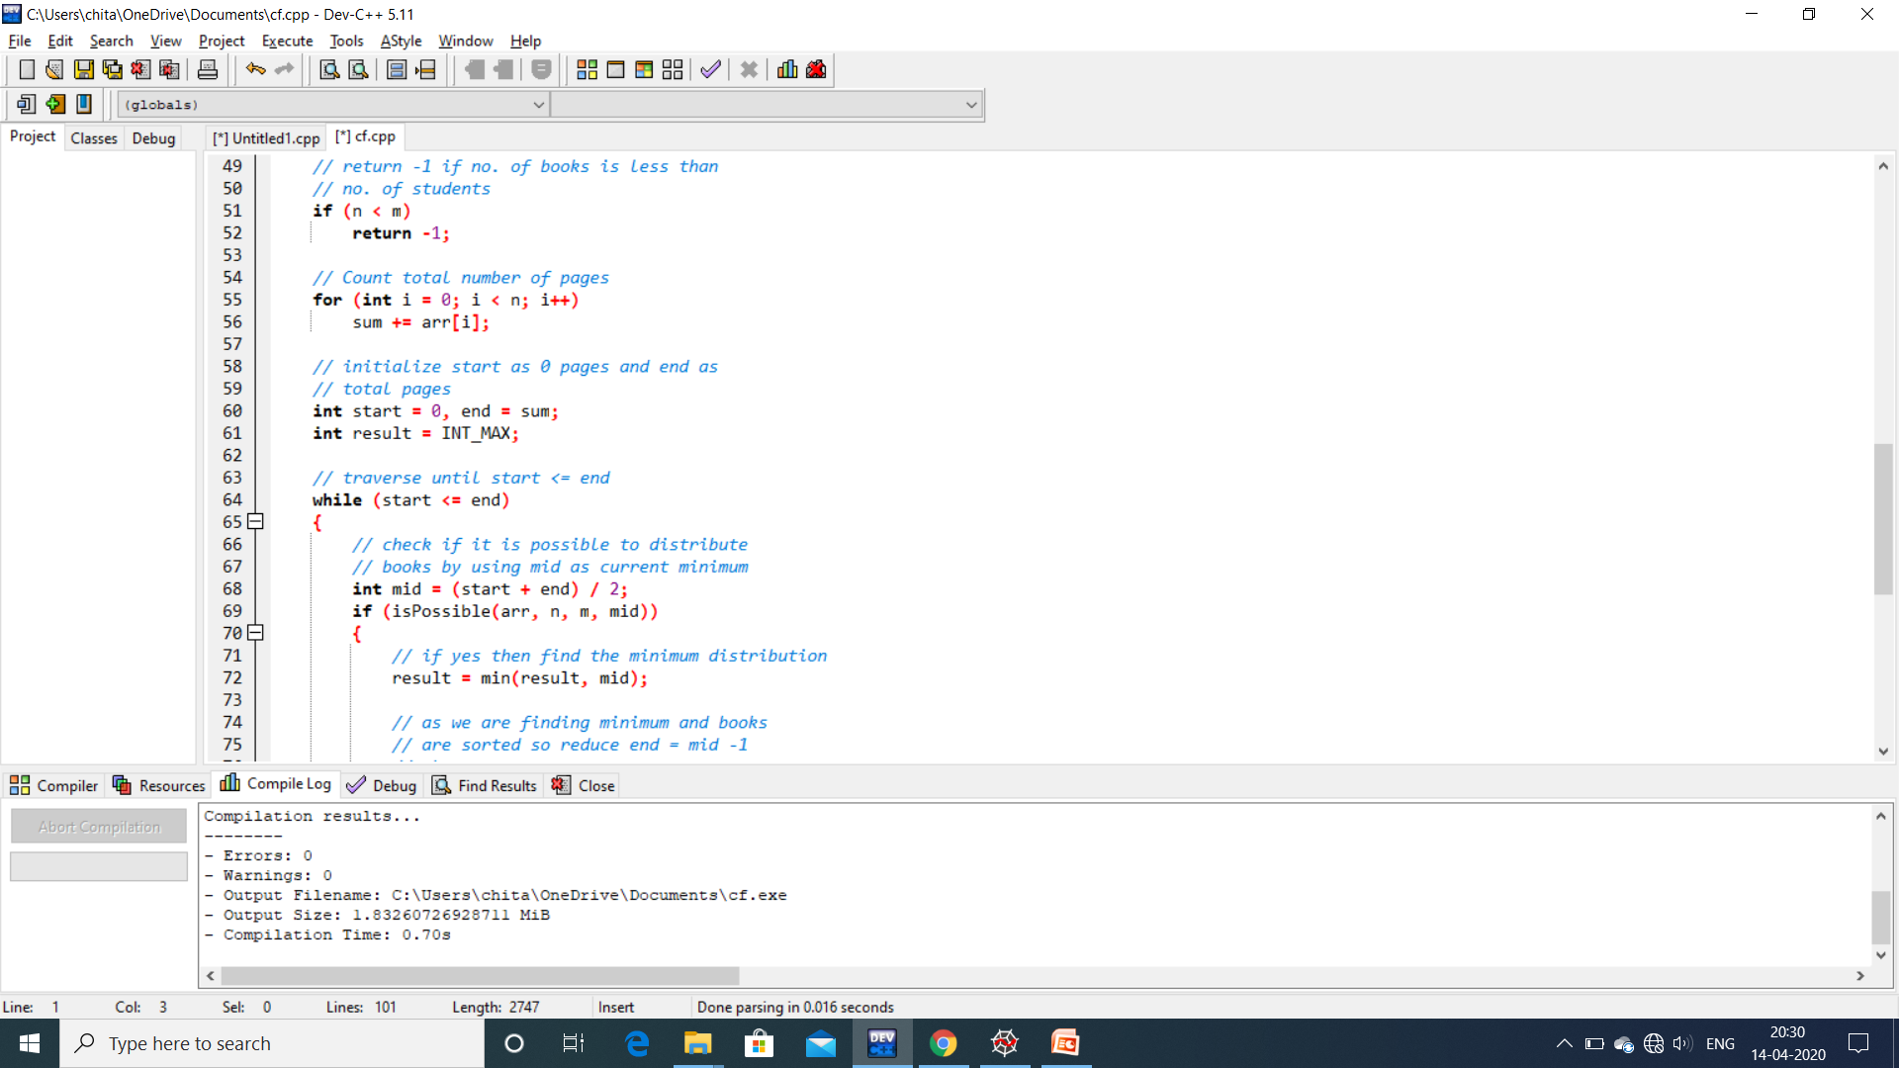

Slide 13


Slide 14
BACKTRACKING
Backtracking is a technique based on algorithm to solve problem. It uses recursive calling to find the solution by building a solution step by step increasing values with time. It removes the solutions that doesn't give rise to the solution of the problem based on the constraints given to solve the problem.

Slide 15
BACKTRACKING
Backtracking algorithm is applied to some specific types of problems,
Decision problem used to find a feasible solution of the problem.
Optimisation problem used to find the best solution that can be applied.
Enumeration problem used to find the set of all feasible solutions of the problem.
In backtracking problem, the algorithm tries to find a sequence path to the solution which has some small checkpoints from where the problem can backtrack if no feasible solution is found for the problem

Slide 16
Maze Puzzle Problem
In the problem, the input given are the size of the square maze and the inputs to build the maze which consist of only 1’s and 0’s where 1 is a part which can be accessed in the maze while 0 is an inaccessible part. The code should be able to find a part(which is constructed with 1’s) from the top left corner of the square maze to the bottom right corner of the maze.
Note: The person starting from top left corner can only move forward(right-side) and down the maze to reach the bottom right side of the maze. The top left and bottom right corner should always be 1 as they are the start and the end points of the maze.

Slide 17
Backtracking Analysis of the Problem
The backtracking method is implemented in this problem to get an efficient code with less time complexity.
In the problem, after taking all the inputs of the maze map, a new matrix is made of the same size of the maze and all the values are initialized to 0.
Then a recursive loop is implemented to check the x and y axis of the matrix after parsing through a series of 1

Slide 18
OUTPUT
The output of the program is square maze with only the final path which reach the end point is visible(which consists of 1’s). All the other remaining 1’s which gives a dead-end are converted to 0
If no particular path is there, the output will display that there is no solution to the maze puzzle.

Slide 19
The solution matrix will check the input maze matrix for 1’s in the right side or the bottom of the matrix, if a 1 is found, it changes the value of that same index in the solution matrix form 0 to 1.
Then the solution matrix continues from that index and check bottom or right again to see if another 1 exist which means that path can be continued.
If the matrix meets a dead end i.e. no path in the right side or bottom side, the pointer backtracks back and set the index value to zero and then find another path from the previous indexes it traversed.
Using this backtracking method, the program finds a path the fastest way possible.

Slide 20
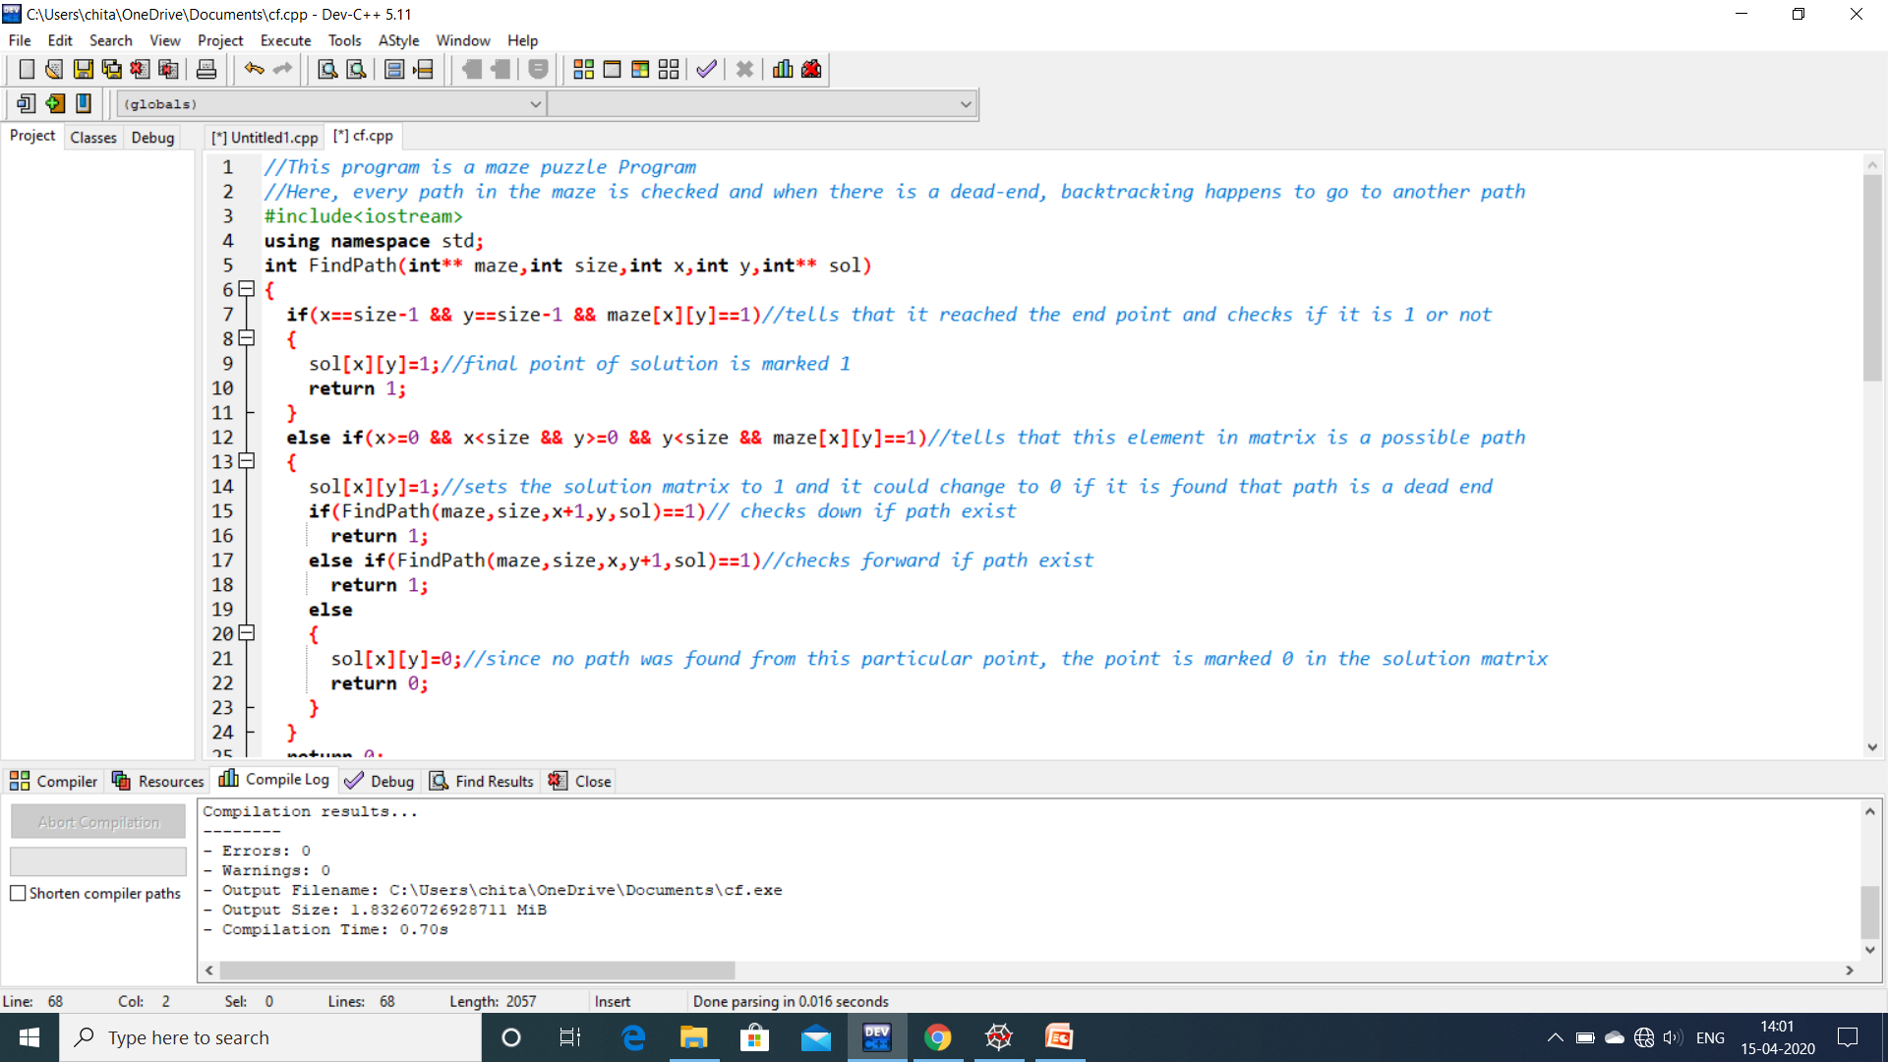

Slide 21
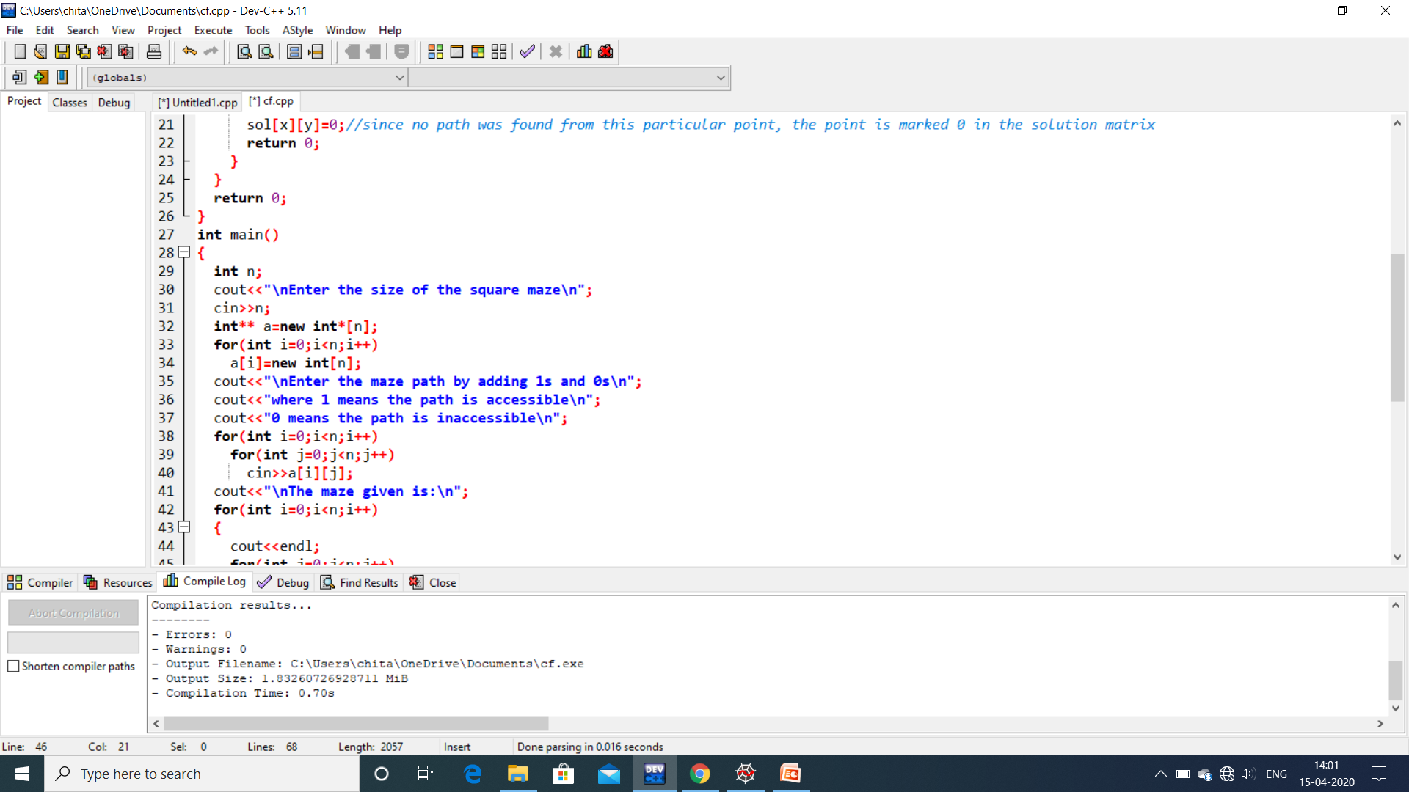

Slide 22
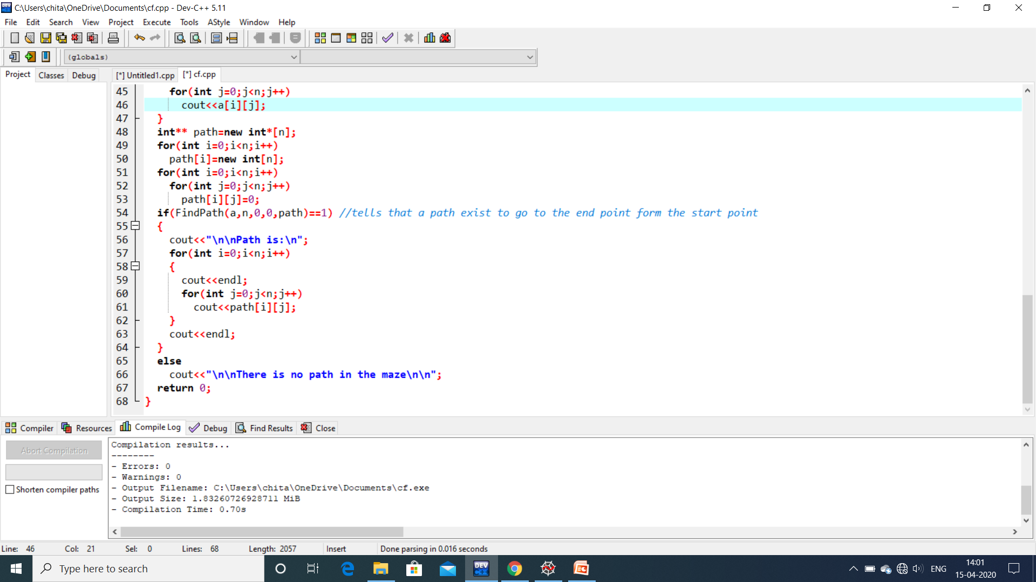

Slide 23
GREEDY ALGORITHMS
Greedy is an algorithmic paradigm that builds up a solution piece by piece, always choosing the next piece that offers the most obvious and immediate benefit. So the problems, where choosing locally optimal also leads to global solution, are best fit for Greedy.

Slide 24
ADVANTAGES AND DISADVANTAGES
It is quite easy to come up with a greedy algorithm (or even multiple greedy algorithms) for a problem.
Analyzing the run time for greedy algorithms will generally be much easier than for other techniques (like Divide and conquer). For the Divide and conquer technique, it is not clear whether the technique is fast or slow. This is because at each level of recursion the size of gets smaller and the number of sub-problems increases.
The difficult part is that for greedy algorithms you have to work much harder to understand correctness issues. Even with the correct algorithm, it is hard to prove why it is correct. Proving that a greedy algorithm is correct is more of an art than a science. It involves a lot of creativity.

Slide 25
Fractional Knapsack Problem
Given weights and values of n items, we need to put these items in a knapsack of capacity W to get the maximum total value in the knapsack.
In Fractional Knapsack, we can break items for maximizing the total value of knapsack.

Slide 26
SOLUTION APPROACH
An efficient solution is to use Greedy approach. The basic idea of the greedy approach is to calculate the ratio value/weight for each item and sort the item on basis of this ratio. Then take the item with the highest ratio and add them until we can’t add the next item as a whole and at the end add the next item as much as we can. Which will always be the optimal solution to this problem.

Slide 27
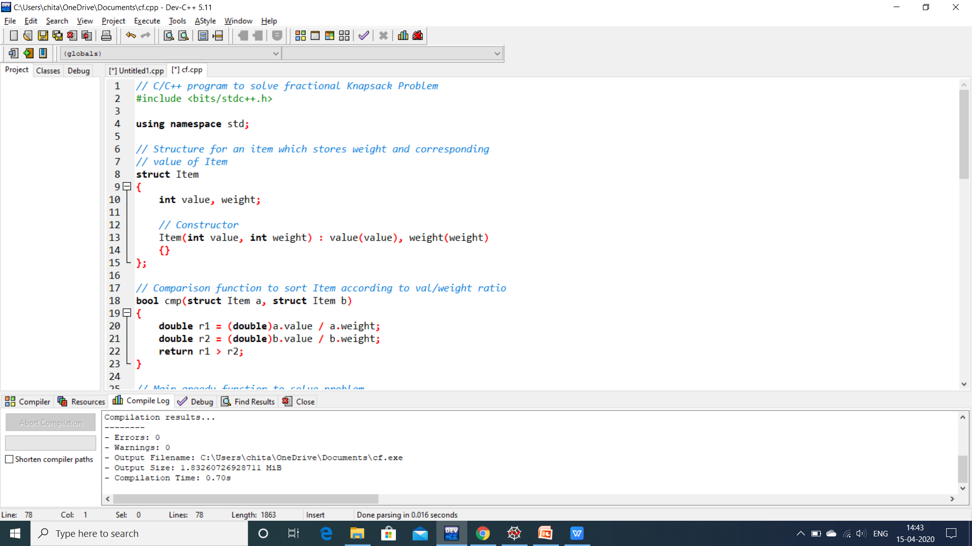

Slide 28
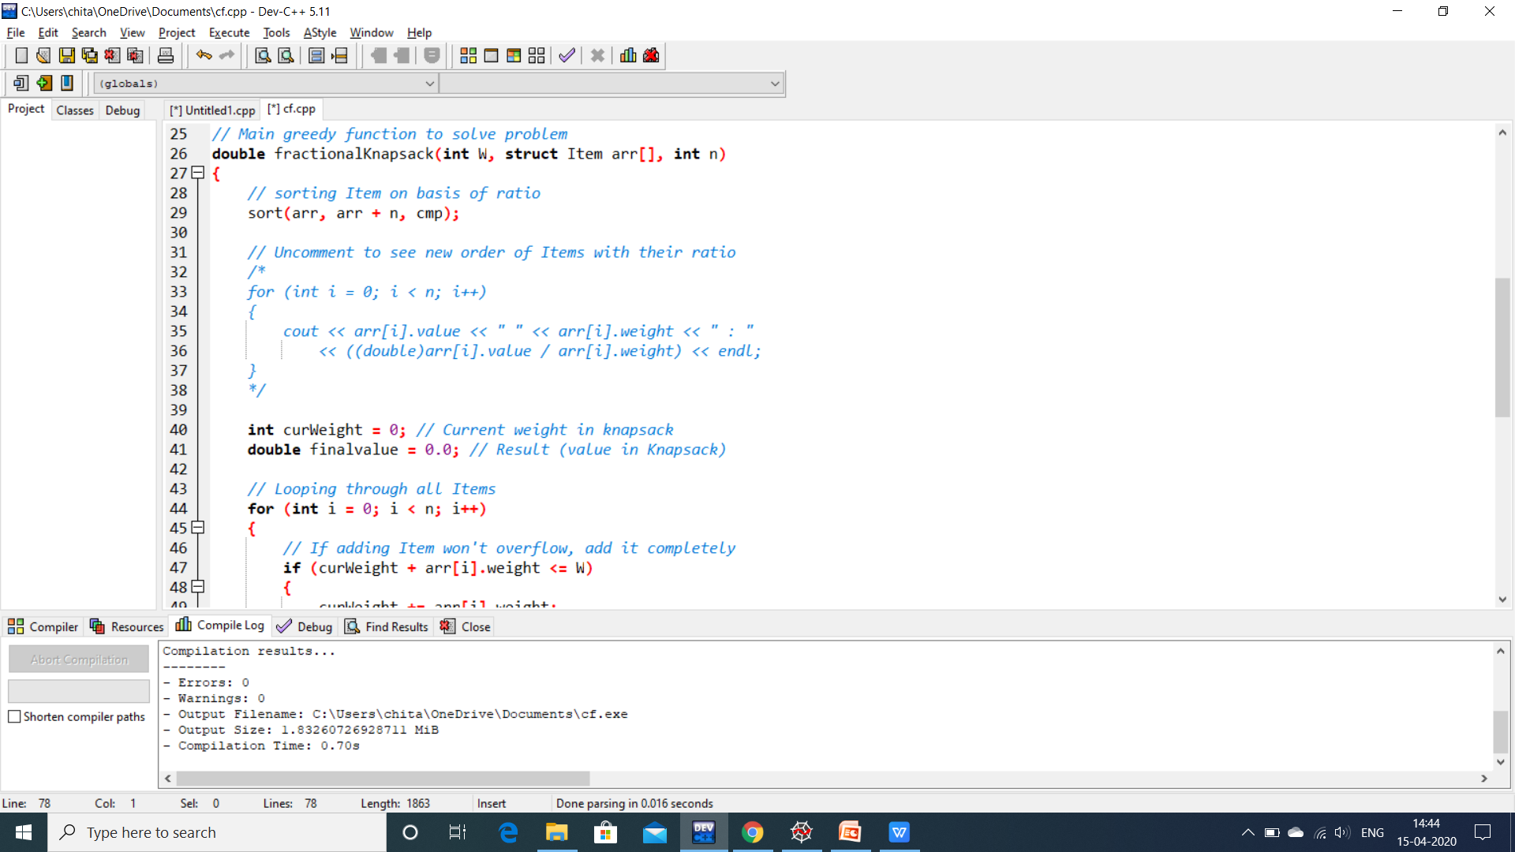

Slide 29
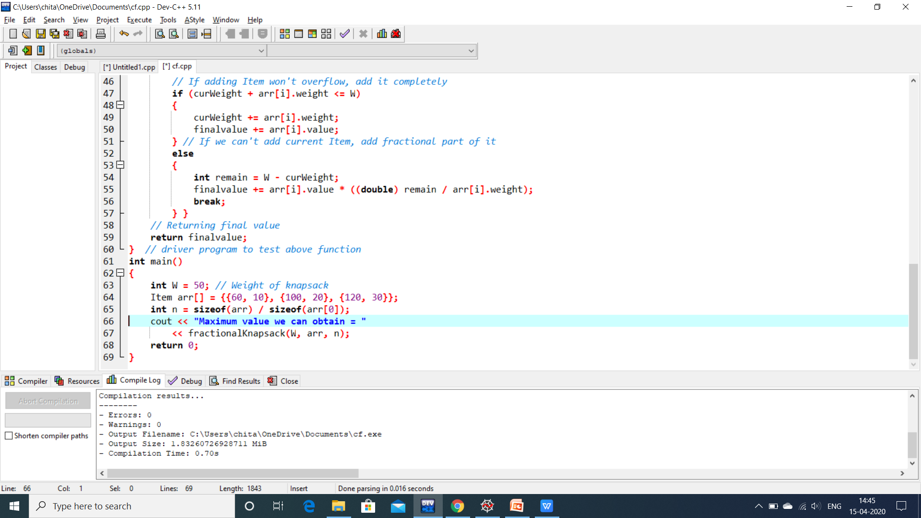

Slide 30
DYNAMIC PROGRAMMING
Dynamic programming and memoization work together. results of these smaller sub-problems are remembered and used for similar or overlapping sub-problems.
Dynamic programming is used where we have problems, which can be divided into similar sub-problems, so that their results can be re-used. Before solving the in-hand sub-problem, dynamic algorithm will try to examine the results of the previously solved sub-problems. The solutions of sub-problems are combined in order to achieve the best solution.
So we can say that −
The problem should be able to be divided into smaller overlapping sub-problem.
An optimum solution can be achieved by using an optimum solution of smaller sub-problems.
Dynamic algorithms use Memoization.

Slide 31
PROPERTIES OF DP
OPTIMAL SUBSTUCTURE-An optimal solution to a sub problem contains optimal solution to sub problem
OVERLAPPING SUBPROBLEMS-A recursive solution contains a small number of distinct sub problems repeated many times.
Dynamic Programming=Recursion +Memoization

Slide 32
DYNAMIC PROGRAMMING APPROACHES
Bottom Up - I'm going to learn programming. Then, I will start practicing. Then, I will start taking part in contests. Then, I'll practice even more and try to improve. After working hard like crazy, I'll be an amazing coder.
Top Down - I will be an amazing coder. How? I will work hard like crazy. How? I'll practice more and try to improve. How? I'll start taking part in contests. Then? I'll practicing. How? I'm going to learn programming.
In Top Down, you start building the big solution right away by explaining how you build it from smaller solutions. In Bottom Up, you start with the small solutions and then build up.

Slide 33
PALINDROME PARTITIONING
Given a string, a partitioning of the string is a palindrome partitioning if every substring of the partition is a palindrome. For example, “aba|b|bbabb|a|b|aba” is a palindrome partitioning of “ababbbabbababa”
Determine the fewest cuts needed for palindrome partitioning of a given string.

Slide 34
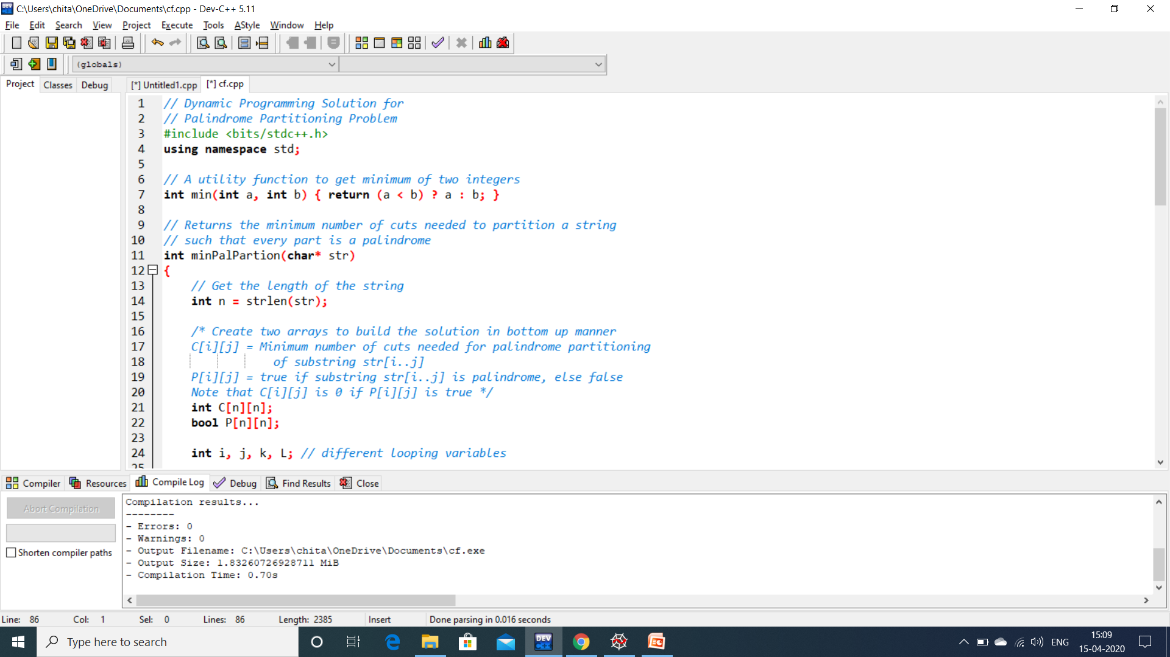

Slide 35
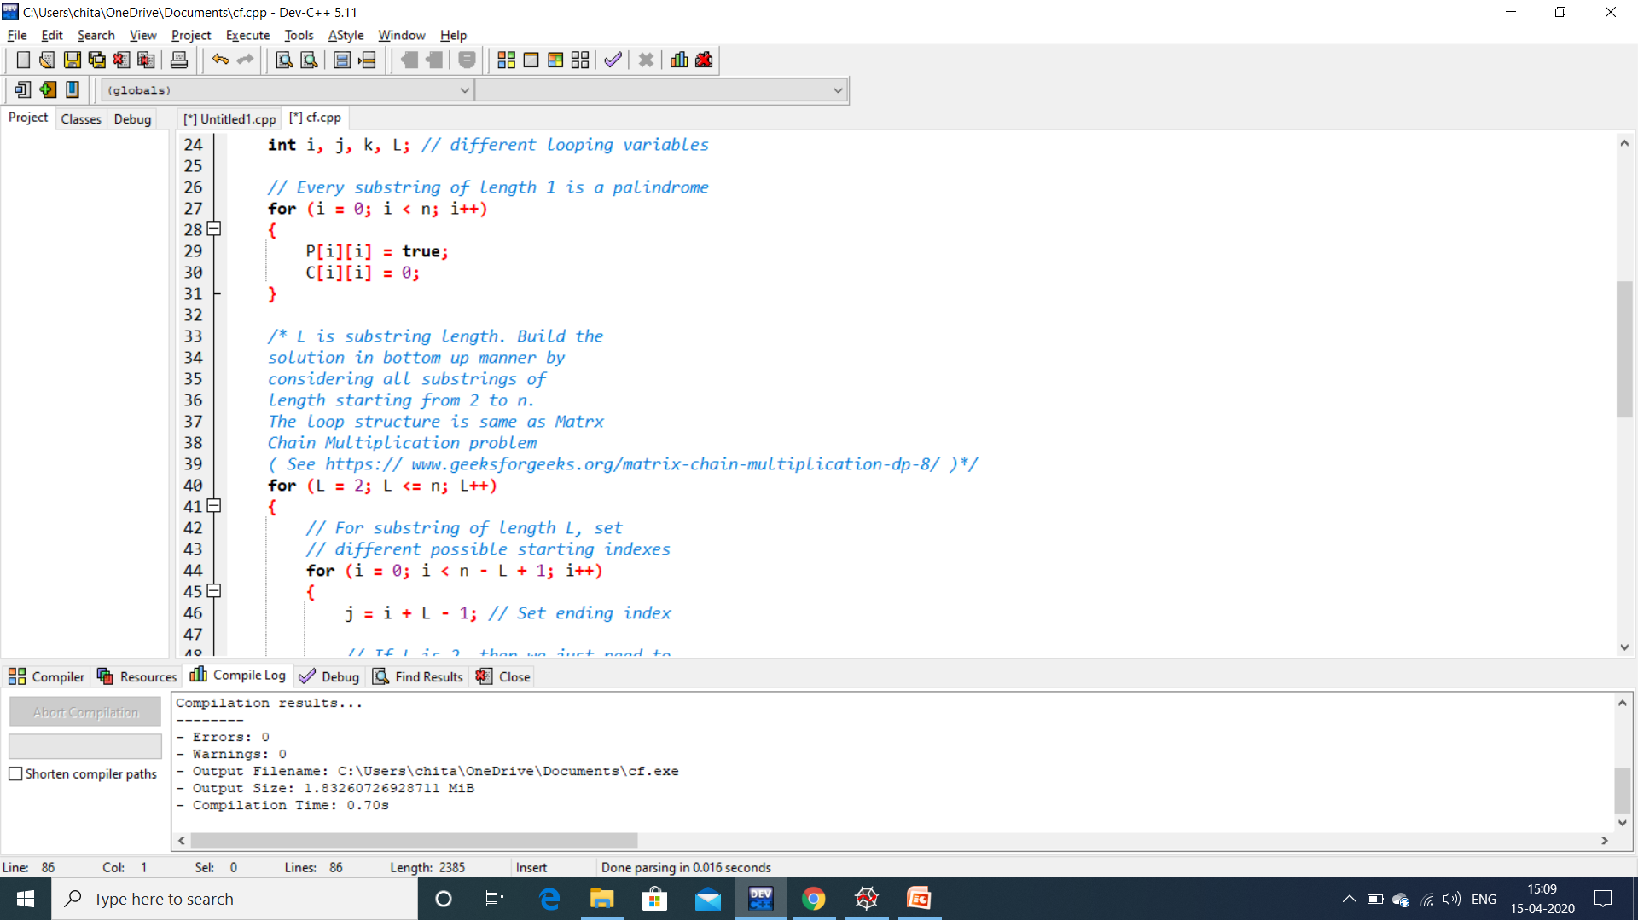

Slide 36
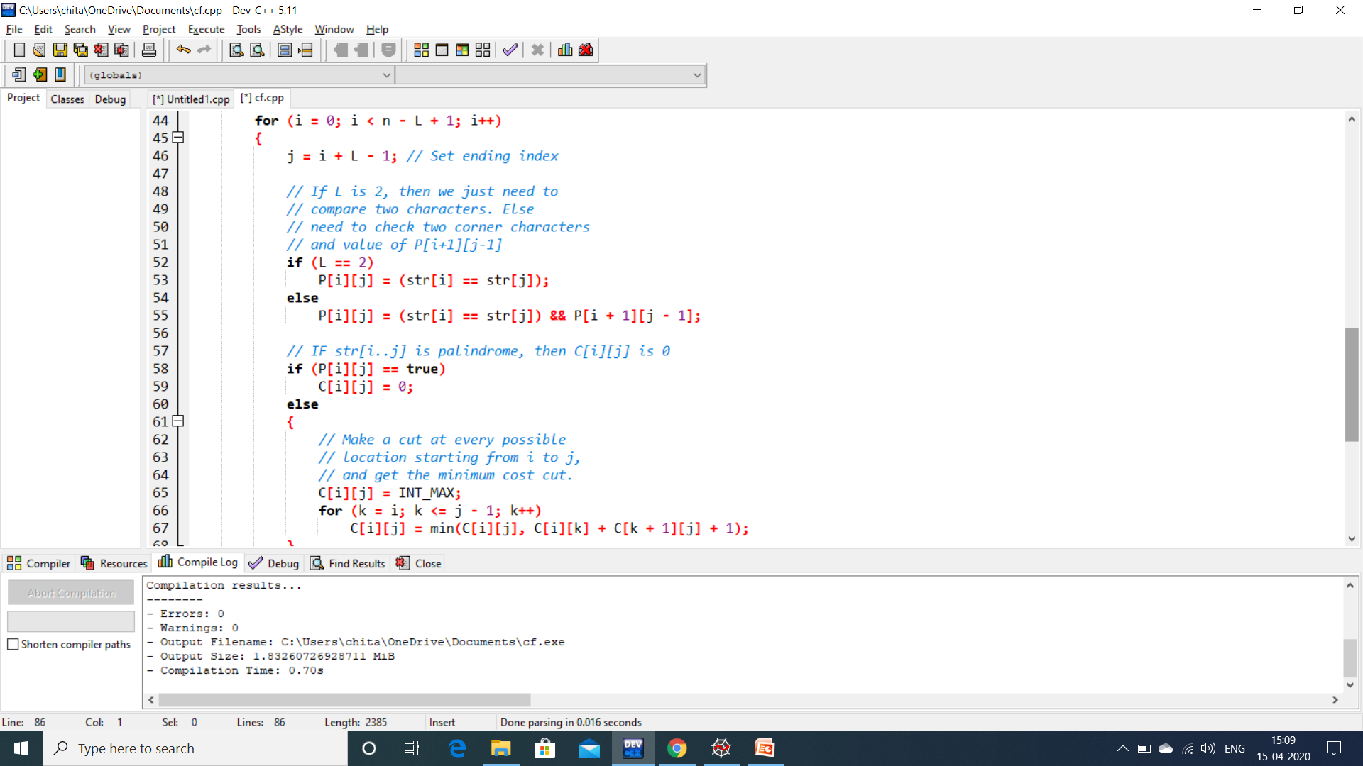

Slide 37
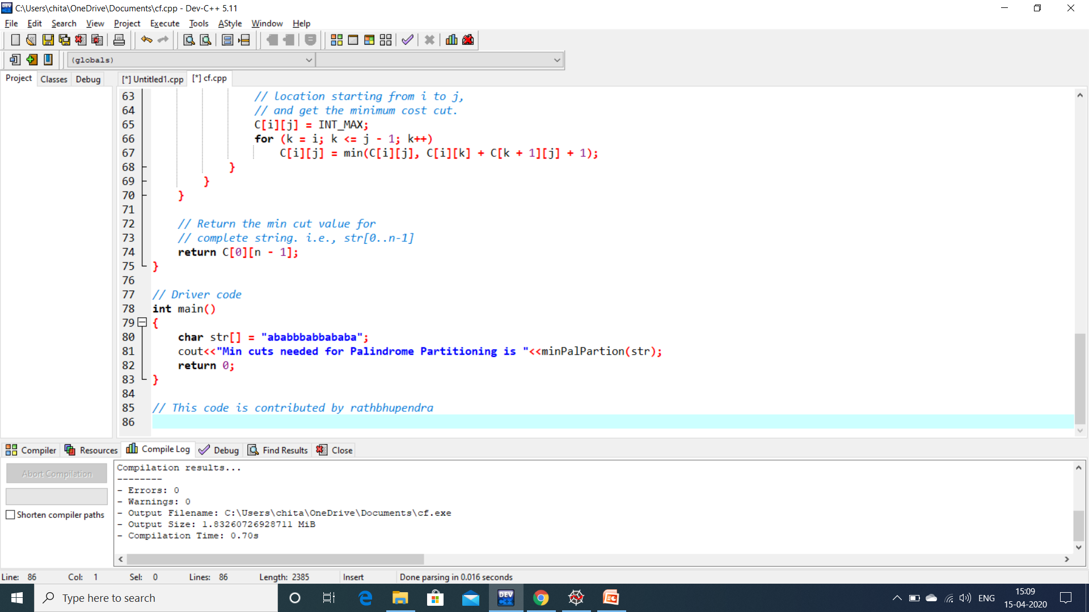

Slide 38
BRANCH AND BOUND
Branch and bound is an algorithm design paradigm which consists of a systematic enumeration of candidate solutions by means of state space search(the set of candidate solutions is thought of as forming a rooted tree with the full set at the root). The algorithm explores branches of this tree, which represent subsets of the solution set. Before enumerating the candidate solutions of a branch, the branch is checked against upper and lower estimated bounds on the optimal solution, and is discarded if it cannot produce a better solution than the best one found so far by the algorithm.

Slide 39
JOB PROBLEM
In the problem, the input given is the size of a matrix which tells the number of workers and jobs available(Both should be equal) and also the user have to enter the cost of each job every worker needs to complete the work. This makes the worker – job matrix. The program should be able to allocate a job to each worker such that a single job goes to a single worker and the sum cost of all the workers assigned to a job should be minimum.
Note: The user should input the cost in the worker – job matrix where each worker’s cost for every job available is entered.

Slide 40
SOLUTION
The branch and bound method is implemented in this problem to get an efficient code with less time complexity.
In the program, a nodal system is used to implement the state space tree. A root node is created and its child will be nodes of worker – job pair where worker 1 will be paired with all the jobs to create separate nodes. Every node will have a path cost variable which will check the total cost of the nodes from their root nodes.

Slide 41
Every node will also have a cost variable which will be the path cost + the overall cost of the best worker – job pair for the workers after the worker in the node.
This will give several nodes at one level, which has the same worker but different jobs and analyse the total path cost of all these pairs and the total cost if the particular job is taken by the worker by calculating the minimum cost of all the workers after the selected worker.
From this nodes in the level, the program chooses the one with minimum cost and continues to another level of nodes branching from the selected node.
At the end of this when all the workers are selected the final node is formed and the cost of the node is the minimum total cost
This space search tree implementation is how branch and bound algorithm is used in the program where out of all nodes a minimum cost node is selected and other nodes are getting branched from that node.

Slide 42
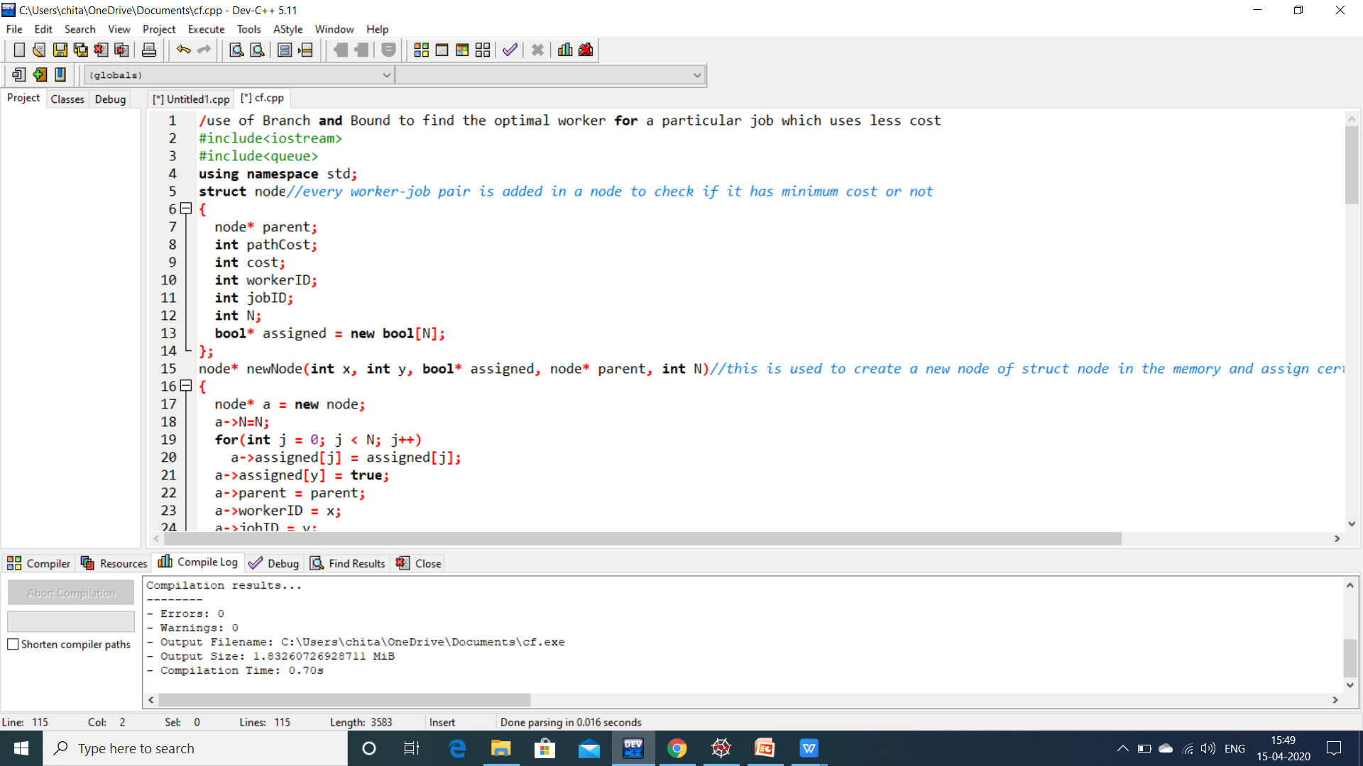

Slide 43
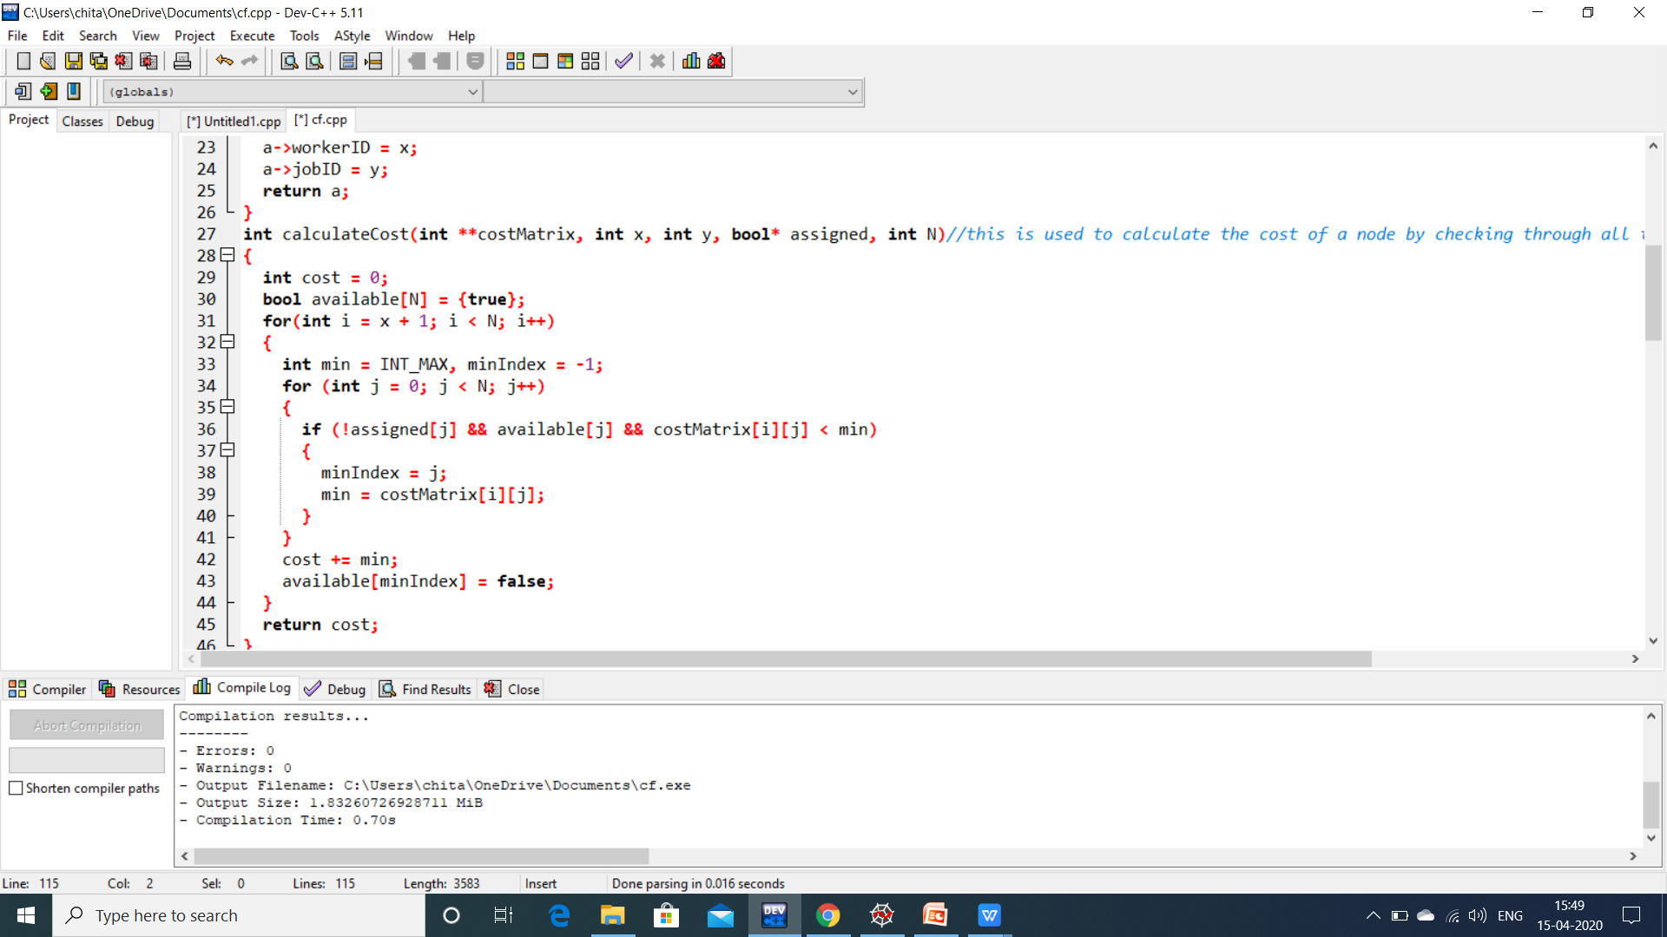

Slide 44
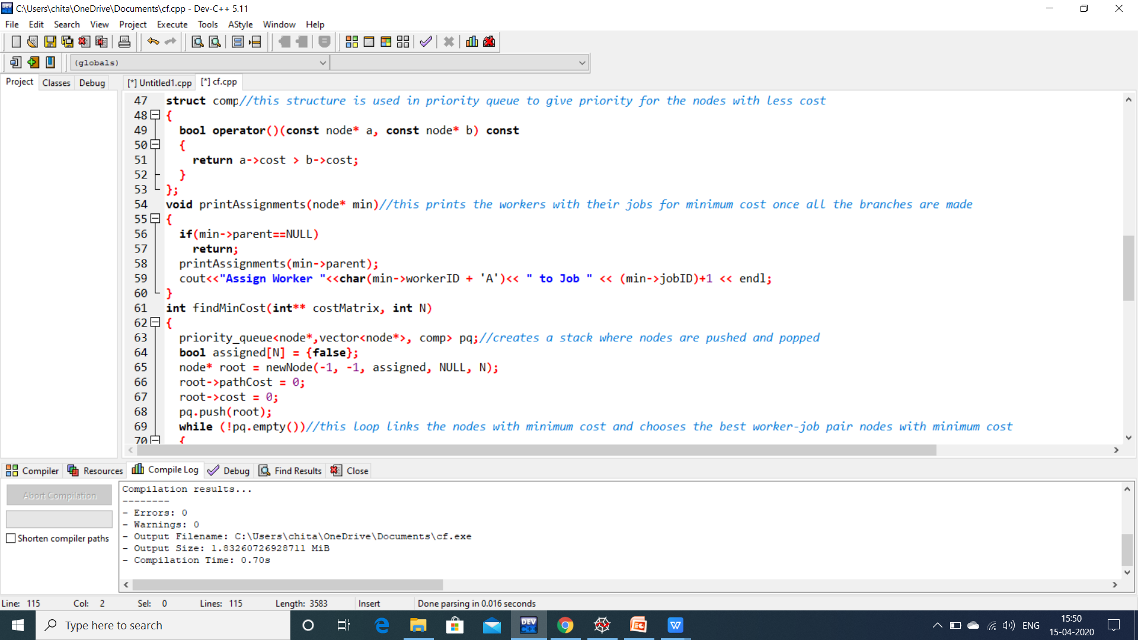

Slide 45
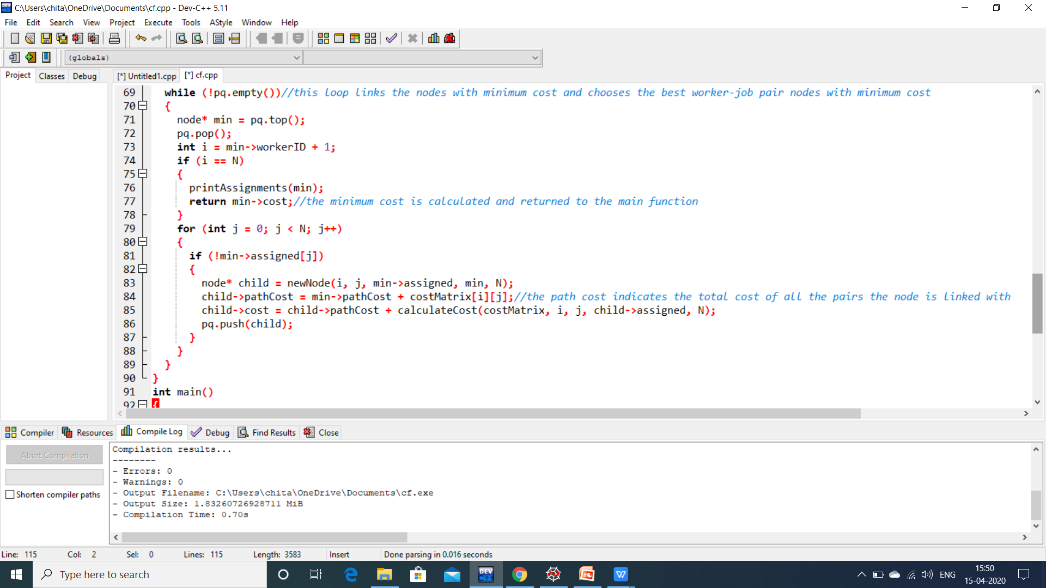

Slide 46
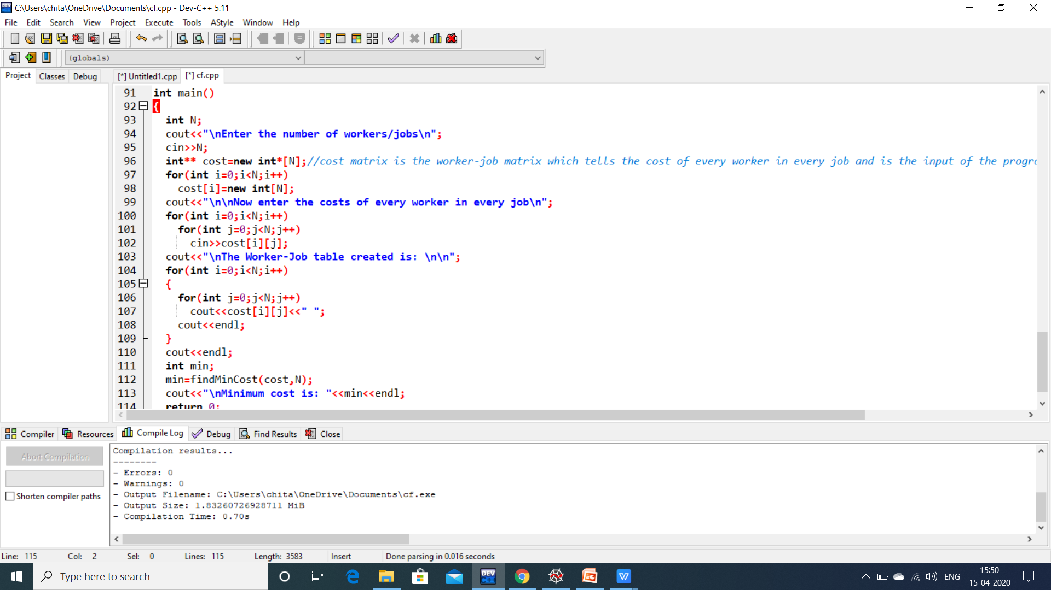

Slide 47
BIBLIOGRAPHY
DESIGN AND ANALYSIS OF ALGORITHMS-Narsimha Karumanchi
Geeksforgeeks
Tutorials point
Hackerearth

